Slide 1
Demand Estimation with Text Embeddings
Gideon Moore
May 11, 2024
Industrial Organization III

Slide 2


Which Movie is This?
From the late 2010s
November release
Sequel to movie from earlier in the decade
Stars Kristen Bell
Joint screenwriter/director
Winter theme
Emphasizes the value of family
Runtime of just over 100 minutes
Grossed more than 5x budget

Slide 3
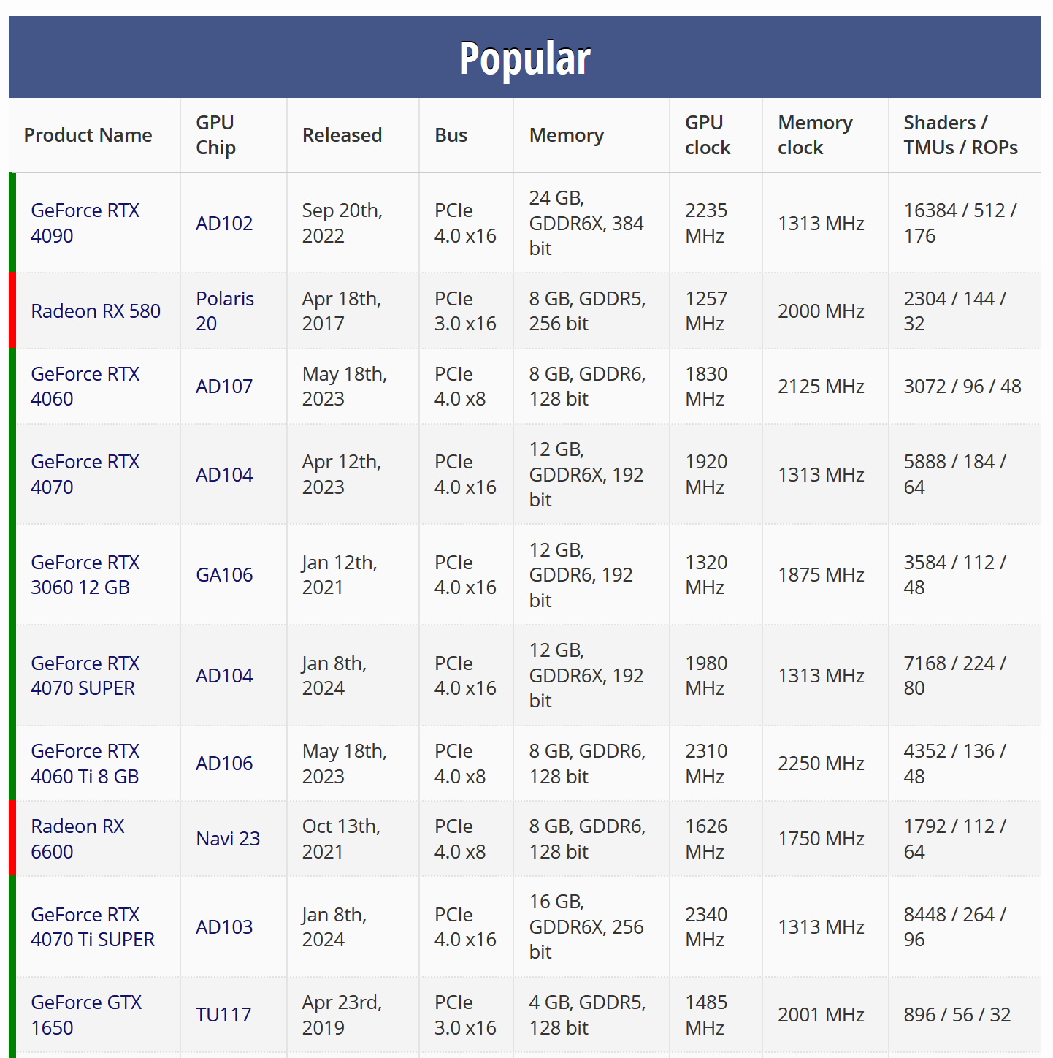
Identifying Good Substitutes is Hard…
Some products have easily-quantifiable characteristics
Computer parts
Energy sources
Grocery staples
However, we care just as (if not more) about substitutability in complex products
More interesting substitutability in monopolistic competition than perfect competition

Slide 4


…But Firms Try to Make It Easy
Firms produce descriptions to convey their products to consumers
If firms are doing their job well, these descriptions should convey necessary information for customer decision-making
Thus, if we can identify information in these descriptions, can more richly identify underlying characteristics

Slide 5

The Goal
This “sounds nice”—firms incentivized to distill the most important information into concise text. How can we make this econometrically useful?
Can use OpenAI text embeddings
Project text into underlying “characteristic space”
Following Magnolfi et al., can use these embeddings to estimate substitution patterns
Proof-of-Concept using Movie Box Office

Slide 6
Existing Literature
Methodology is most similar to Magnolfi et al. 2022
Uses triplet embeddings to estimate substitution in ready-to-eat breakfast cereal
Iterates on Compiani, Morozov, and Seiler 2023
Primarily uses image data to estimate substitution in tech purchases on Amazon
Also makes a nod towards text methods, but nothing high-tech: mostly bag-of-words, with some cursory BERT work
Contribution:
Novel setting where text characteristics are important with few substitutes
Unique market characteristics make tools uniquely effective
Uniform Pricing
Immutable Product Characteristics

Slide 7
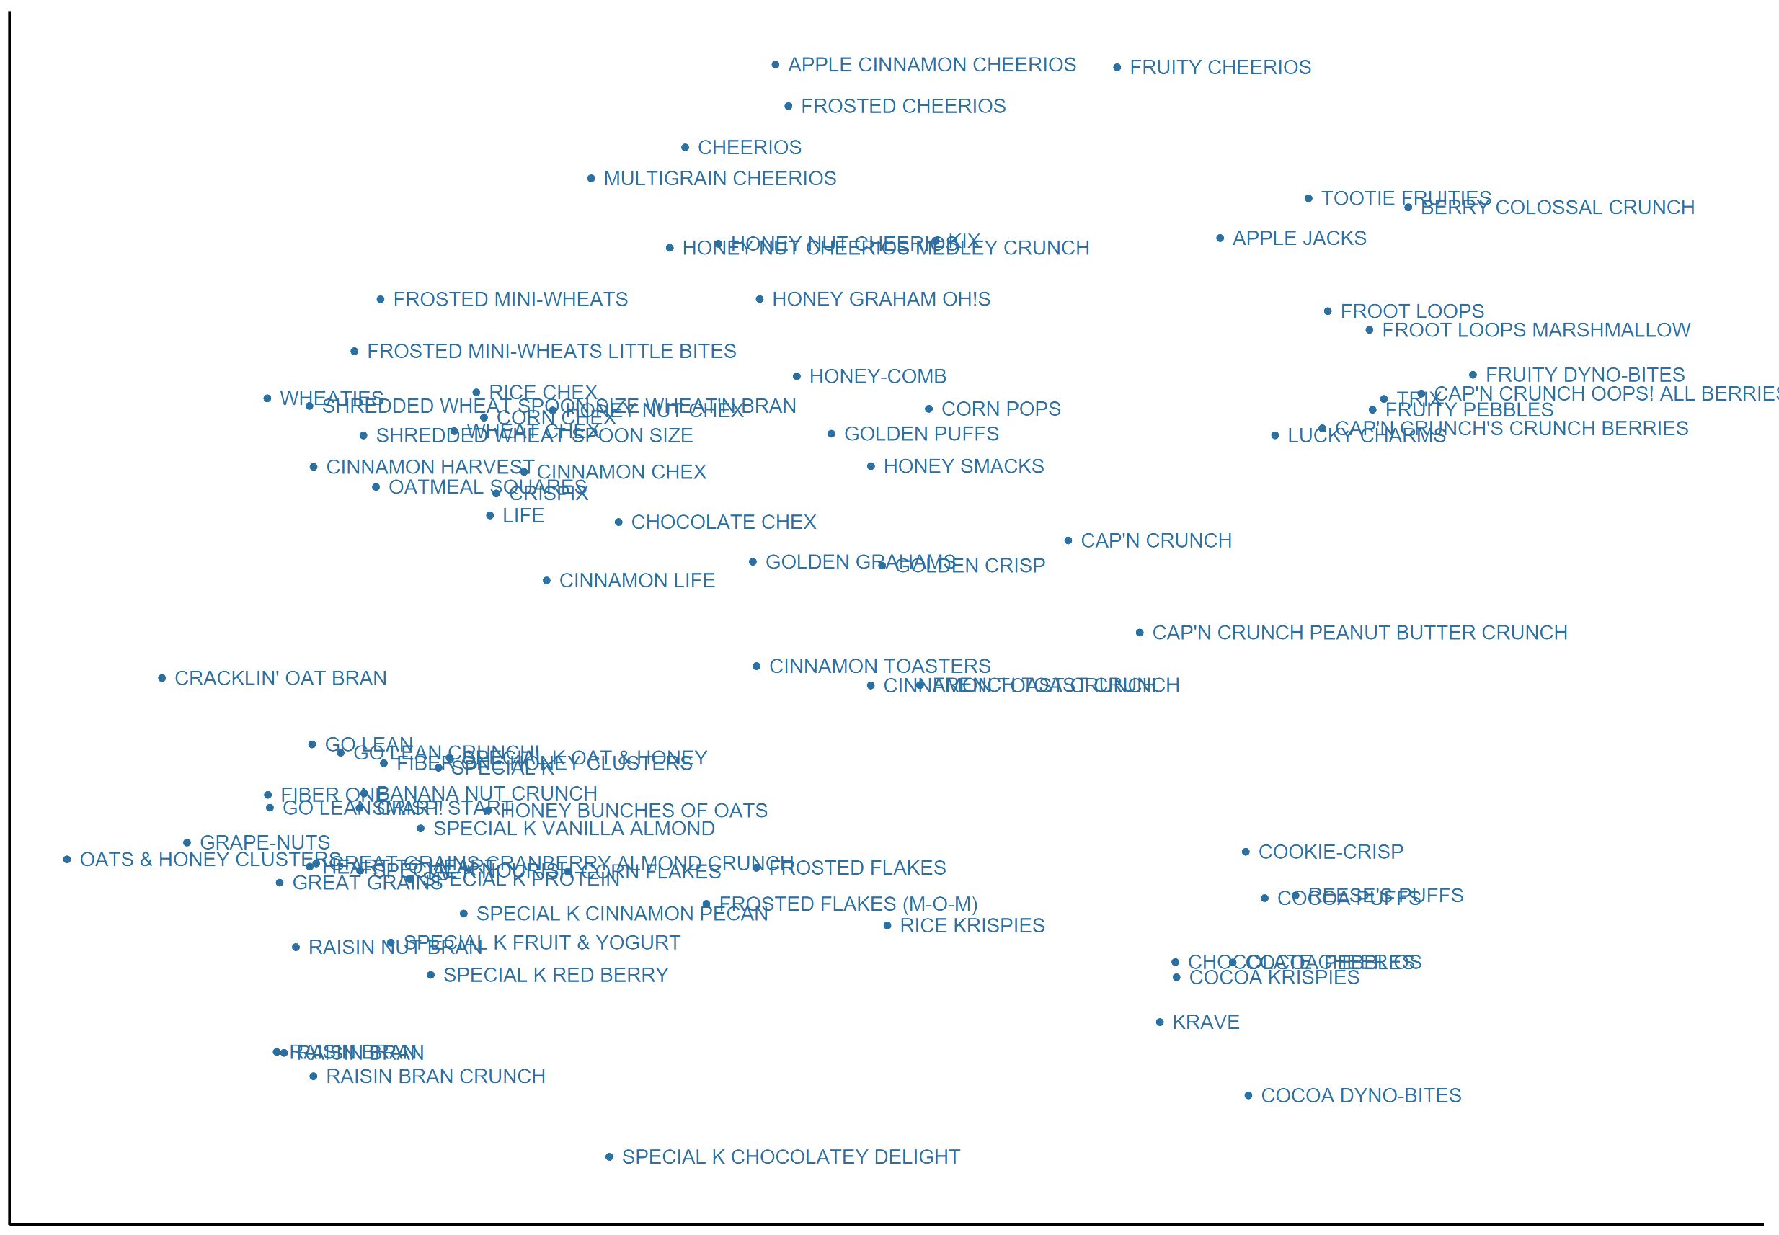
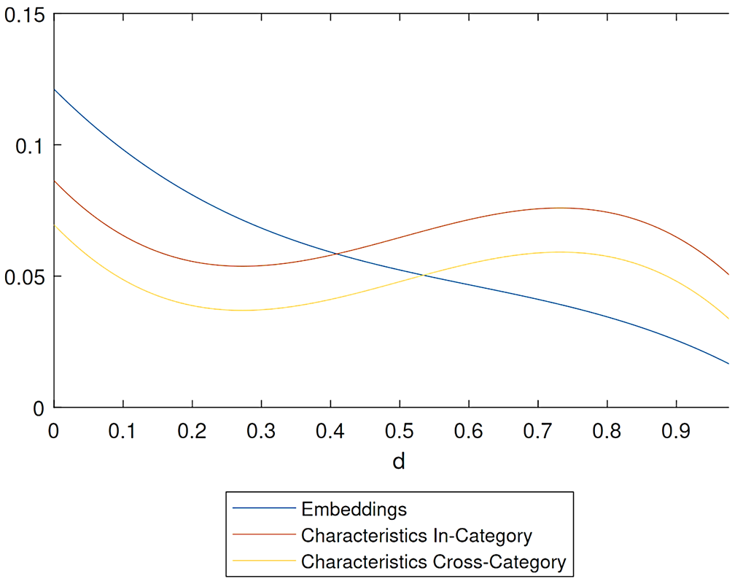
Refresher: Magnolfi
Shredded Wheat
Fruity
Chocolate
Magnolfi used triplet embeddings to cluster cereal brands
From there, showed that predicting substitution with these characteristics was better than using interpretable characteristics
Cross-price elasticity monotonically decreasing in distance

Slide 8
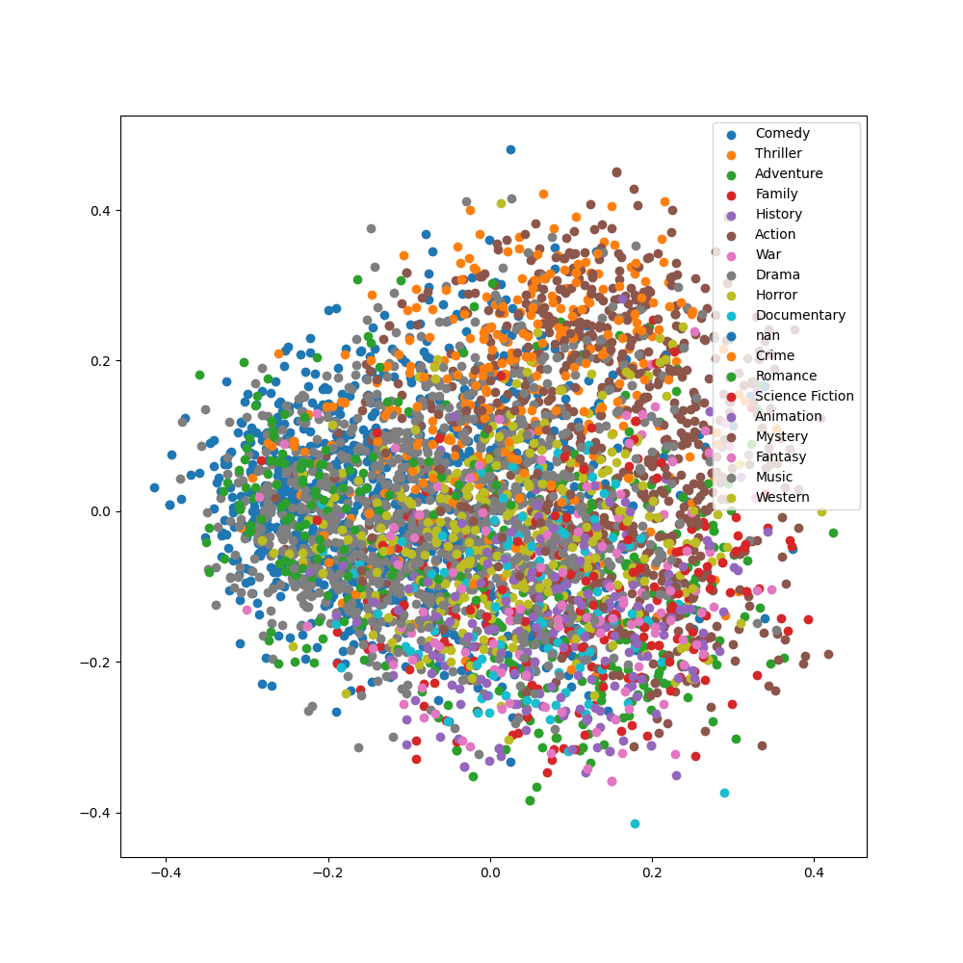
Results Preview
Thriller/Action
Characteristics seem compelling given genre clustering
Elasticity estimates have reasonable:
Sign
Magnitude
Derivative
Minimal(-ish) structural assumptions
Romantic Comedy
Sci-Fi/Fantasy

Slide 9
Model & Application

Slide 10
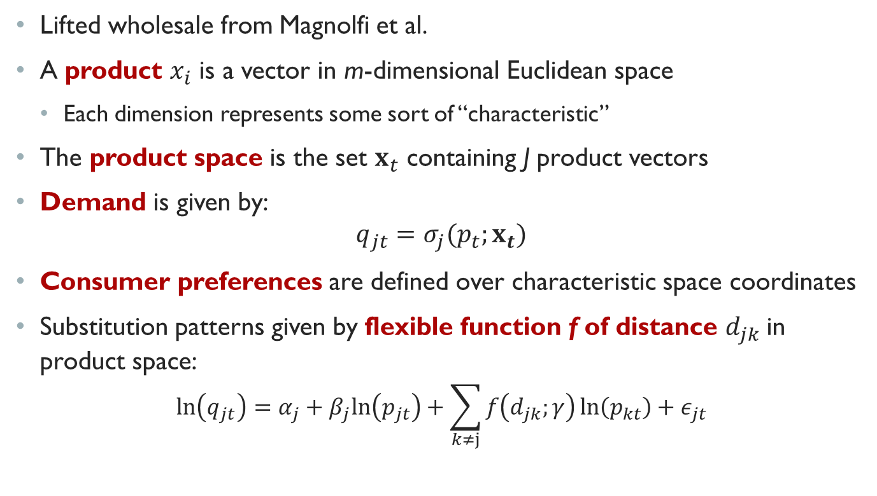
The Model
Lifted wholesale from Magnolfi et al.
A product $x_{i}$ is a vector in m-dimensional Euclidean space
Each dimension represents some sort of “characteristic”
The product space is the set $x_{t}$ containing J product vectors
Demand is given by:
$$q_{jt}=σ_{j}(p_{t};x_{t})$$
Consumer preferences are defined over characteristic space coordinates
Substitution patterns given by flexible function f of distance $d_{jk}$in product space:
$$\ln\left(q_{jt}\right)=α_{j}+β_{j}ln\left(p_{jt}\right)+\sum_{k≠j}{f\left(d_{jk};γ\right)\ln\left(p_{kt}\right)}+ε_{jt}$$

Slide 11
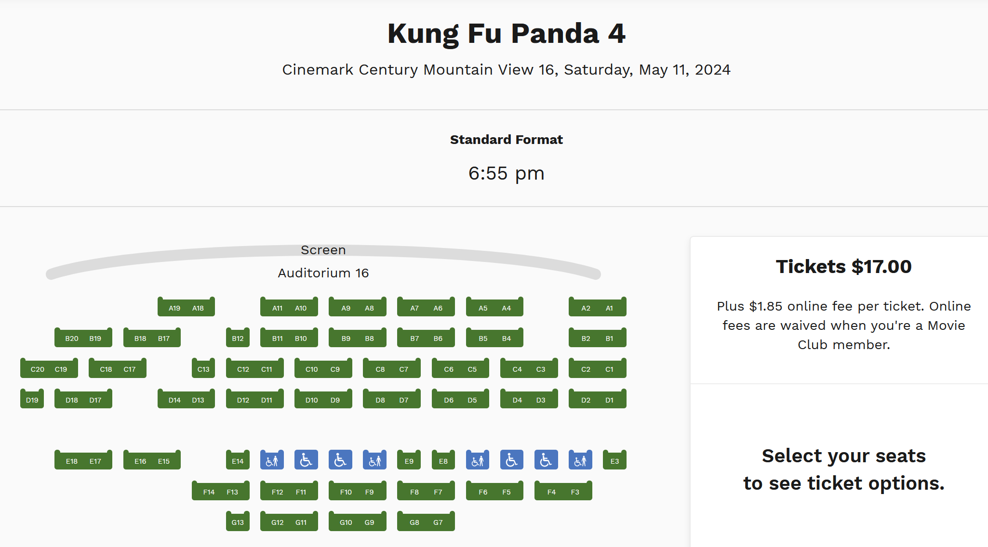
Why Movies: Uniform Pricing Puzzle
Normally, demand estimation requires cost shifter to parse apart pricing response to competition
Movies have distinctive pricing structure: all movies cost the same
We don’t need to worry about why—just that there is no pricing response
Well-documented (though maybe starting to change?)
Orbach and Einav (2007)
Chung (2015)
Ho (2018)
Charging $17 despite having not sold a single seat!
(Movie released 3/8/24, retrieved on 5/11/24)

Slide 12


Why Movies: Exogeneous Characteristics
To estimate anything in these models, need exogeneous characteristics
Otherwise, elasticity confounded with strategic response
Twin Films suggest inability to change movie characteristics
Bug’s Life/Antz
No Strings Attached/Friends with Benefits
Olympus Has Fallen/White House Down
Notably, these films (generally) do terribly
Suggests substitution is real and should be avoided if possible—but isn’t

Slide 13
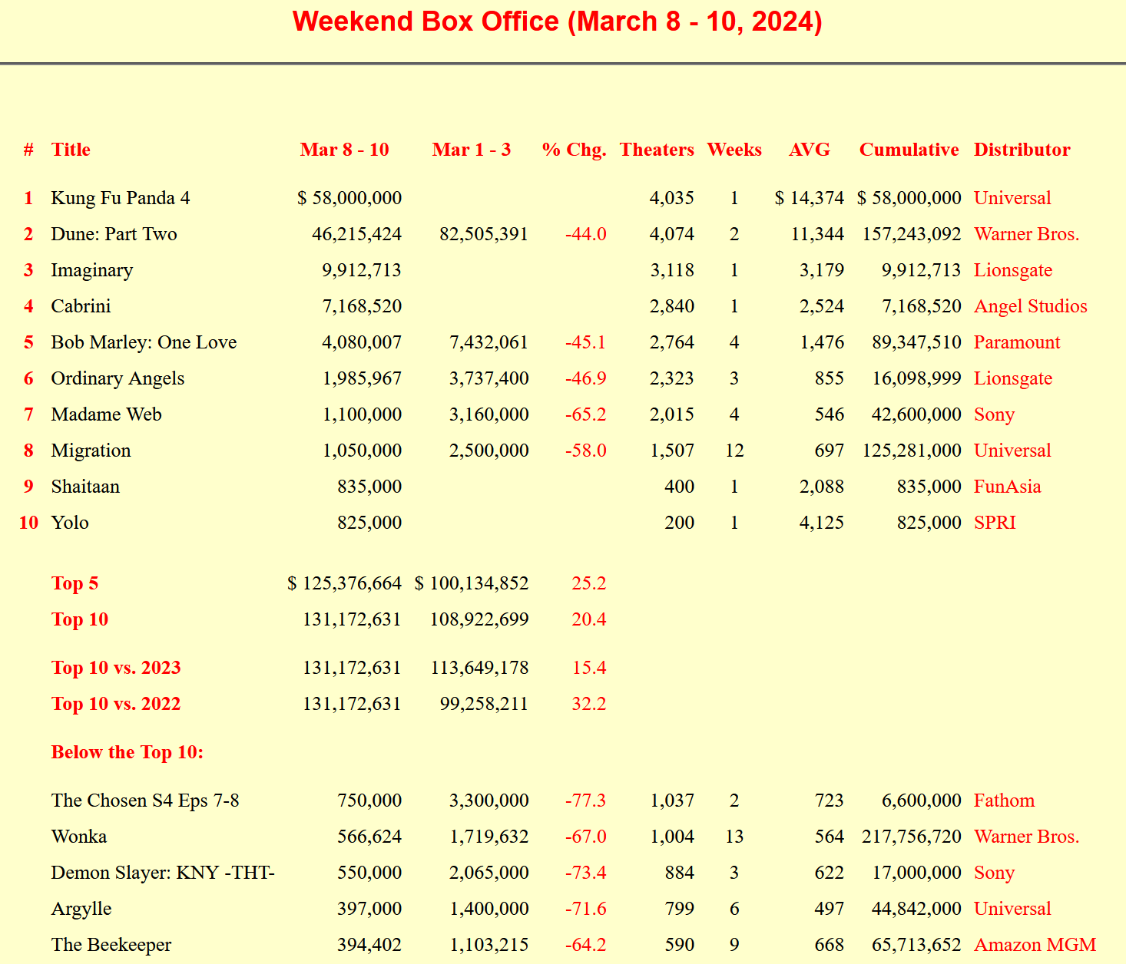
Data
Box office receipts scraped weekly from BoxOfficeGuru
1998-Present, with gaps
Descriptions pulled from TheMovieDB
Free IMDB Competitor
Using Search API: search for “cleaned” title in year observed in box office data
Embeddings performed using OpenAI text-embedding-3-small engine from April
~1,500 dimensional, but reduced to six with PCA

Slide 14
Clustering Results

Slide 15
Genre Clustering
Thriller/Action
Given 1,500-dimensional vectors from OpenAI
Collapse to 2D with t-SNE for visualizations
Use 6D PCA for estimation
Generally clusters movies of same genre without prompting
Similar genres are clustered
Too many genres for standard color palate without superimposing
Romantic Comedy
Sci-Fi/Fantasy

Slide 16
Log-Linear Demand Model

Slide 17
Log-Linear Demand Model
$$\ln\left(q_{jt}\right)=α_{j}+α_{t}+β_{j}\ln\left(p_{jt}\right)+\sum_{k≠j}{f\left(d_{jk};γ\right)\ln\left(p_{kt}\right)+γ⋅age_{jt}+ε_{jt}}$$
Lifted near-wholesale from Magnolfi, except:
Prices are constant given uniform pricing—all absorbed into intercept
Movies thrive on novelty, so add movie-age fixed effects
Uniform pricing allows proxying for quantity with total box-office revenue
Function f interpretable as cross-elasticity

Slide 18
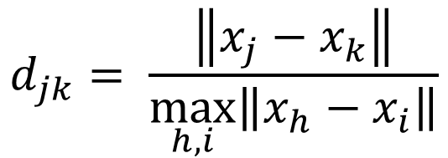
Functional Form
Again following Magnolfi, use a normalized cubic polynomial:
Note normalized using furthest observed distance; computing each possible pairwise distance quite intensive
$$f\left(d_{jk};γ\right)=γ_{0}+γ_{1}d_{jk}+γ_{2}d_{jk}^{2}+γ_{3}d_{jk}^{3}$$
$$d_{jk}= \frac{\left\|x_{j}−x_{k}\right\|}{\max_{h, i}\left\|x_{h}−x_{i}\right\|}$$

Slide 19
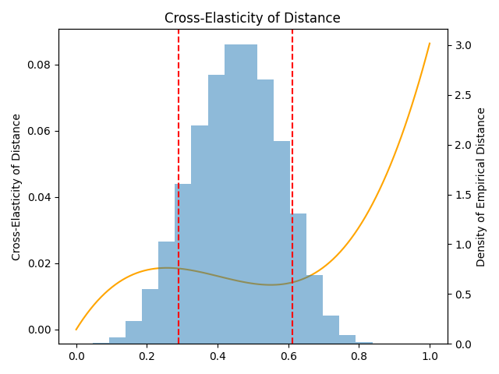
Cross-Elasticities Over Euclidean Distance
Histogram in background plots support of the data
Thus, we see impact generally falls monotonically(ish) with distance

Slide 20
Nearest Neighbors Sanity Checks Euclidean Distance
To make sure these projections work in higher dimensions, I also check the nearest neighbors of some movies in other genres. While not ideal, I think they seem reasonable.
Movie | Nearest Neighbor #1 | Nearest Neighbor #2
Frozen | Little Mermaid | Princess Diaries 2
Dune: Part 1 | Dune: Part 2 | Black Panther II
The Notebook | Collateral Beauty | I Still Believe
Avengers: Endgame | X-MEN: Days of Future Past | Guardians of the Galaxy 3

Slide 21



Interpretation
Disney is launching Frozen this weekend
During the same weekend, Pokémon: The Movie 2000 is showing
10th percentile distance from Frozen
Suppose instead we replaced Pokémon with Sandra Bullock’s Premonition
90th percentile distance from Frozen
Model suggests 0.0044 log-point bump in quantity
i.e., around 0.44% revenue increase
Seems reasonable?

Slide 22
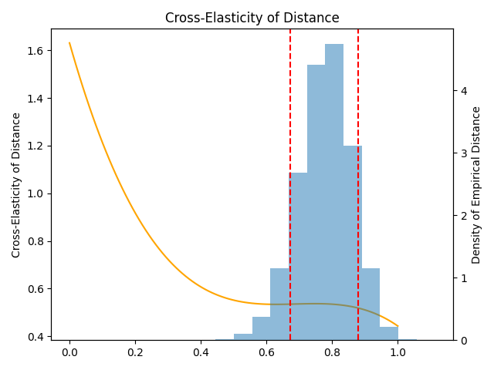
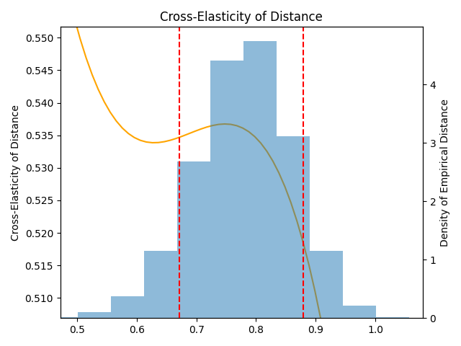
Cross-Elasticities Over Cosine Distance
Instead of Magnolfi’s 6D Euclidean distance, we can instead use the cosine distance of the raw embedding
Slightly non-monotone, but uses more richness in the data
Produces better tail behavior and more reasonable neighbors

Slide 23
Nearest Neighbors Sanity Checks Cosine Distance
I think the nearest neighbors seem “better” when using the cosine distance (but maybe you disagree)
Movie | Nearest Neighbor #1 | Nearest Neighbor #2
Frozen | Frozen II | Mirror Mirror
Dune: Part 1 | Dune: Part 2 | Voyagers
The Notebook | Message in a Bottle | The Longest Ride
Avengers: Endgame | Avengers: Infinity War | Captain America: Civil War

Slide 24


Interpretation
Disney is launching Frozen this weekend
During the same weekend, Inkheart is showing
10th percentile distance from Frozen
Suppose instead we replaced Inkheart with Medieval
90th percentile distance from Frozen
Model suggests 0.0162 log-point bump in quantity
i.e., around 1.64% revenue increase
Reasonable to be larger if picking up “better” signal

Slide 25
Conclusion

Slide 26
Efficacy of Text Embeddings
Text embeddings produce reasonable substitution patterns on the support of the data while mimicking real decision-maker information
Captures characteristics firm believes are most important
Permits little room for researcher judgement
Astoundingly cheap: this whole project cost <$0.03

Slide 27

Next Step: Benchmarking
Thus far, validating based on what “looks right”
Research that only confirms priors is unhelpful
Benchmark with real taste patterns
MovieLens released 25m movie ratings from real users
Includes TMDB ID for linking to existing data
Would need recommendation engine (textbook examples)

